Slide 1
UBER SUPPLY-DEMAND GAP CASE STUDY SUBMISSION
Submitted By : Shivali Dalmia

Slide 2
Uber Supply-Demand Gap Analysis
Problem:
Uber is facing loss of revenue due to driver cancellation or non availability of cars for majority of requests.(Airport to City/City to Airport)
This is laying down a bad impact on uber business and its customers.
Goal of Analysis:
Identify the root cause of problem i.e time slot for which maximum supply demand gap exist.
Identify the type of requests i.e Airport to City or City to Airport which is more problematic in case of driver cancellations or non availability of cars.
Recommend possible ways to improve the situation.

Slide 3
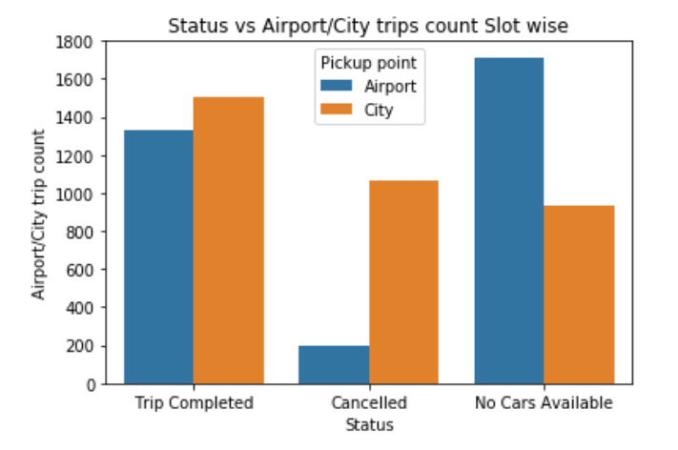
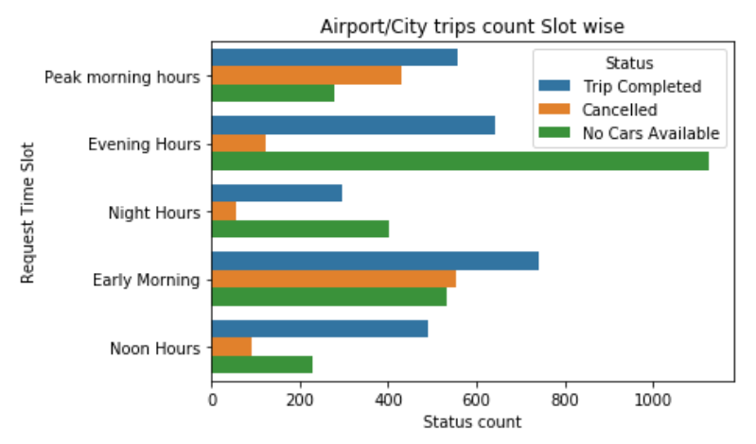
Step by Step Approach
Plot the count plot for Status vs Pickup Point column of dataset.
Step-1 Step-2
Step-3
After cleaning the master data identify request/drop hours for each trip.
Determine frequency for each request status against pickup point.
Determine time slots when maximum trips were completed/canalled/no cars available.
Plot ‘Request Time slot’ against Status.
# 1am – 7am - Early Morning
# 8am – 11am - Peak morning hours
# 12pm – 4pm - Noon hours
# 5pm – 8pm - Evening hours
# 9pm – 11pm - Night Hours
Contd. On next slide

Slide 4
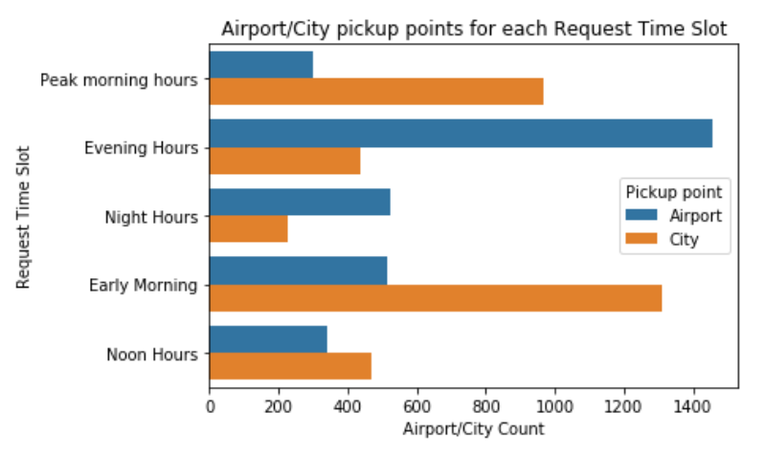
Step - 4
Step - 5
Determine the time slot when maximum number airport/city pickup request came.
Plot ‘Request Time Slot’ vs ‘Pickup Point’ .
Calculate the total gap using formula:
Gap = Total Demand – Total Supply
Plot ‘Request Time Slot’ vs ‘Pickup Point’ .
Total Demand :6745 approx.
Total Supply :2831 approx.
Total Gap :3914 approx.

Slide 5
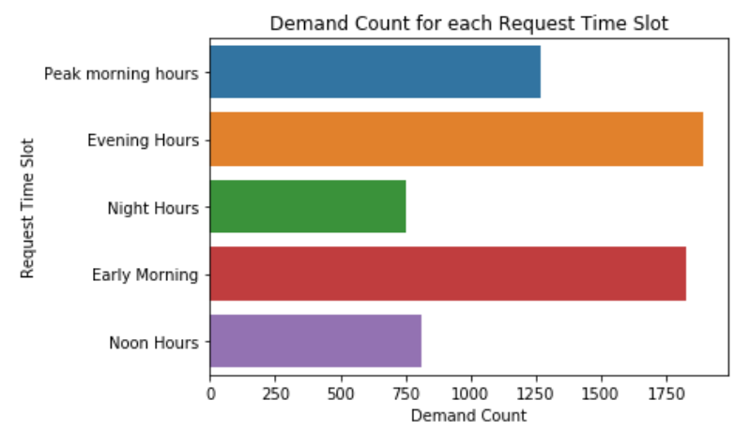
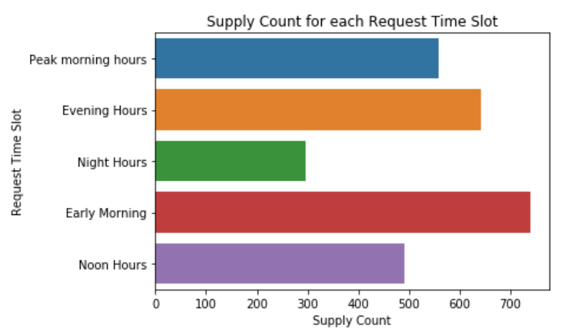
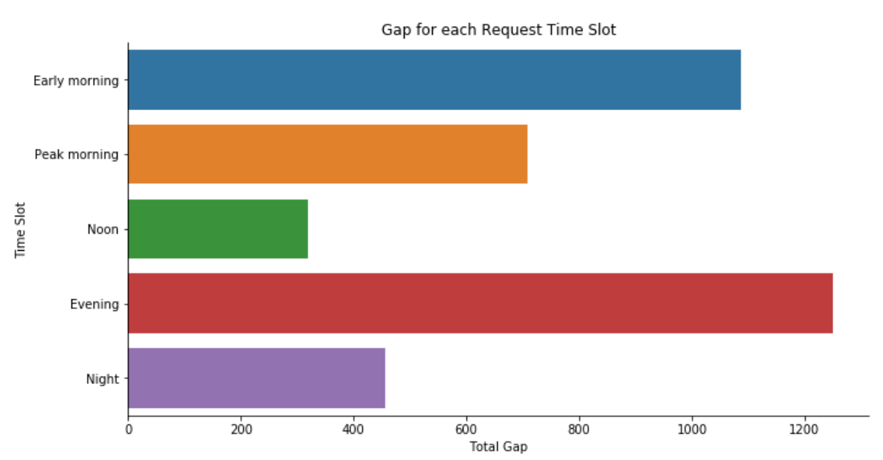
Step - 6
Step - 7
Calculate demand for each time slot.
Plot ‘Request Time Slot’ vs ‘Demand’.
Calculate supply for each time slot.
Plot ‘Request Time Slot’ vs ‘Supply’.
Calculate gap for each time slot.
Plot ‘Request Time Slot’ vs ‘Gap’.

Slide 6
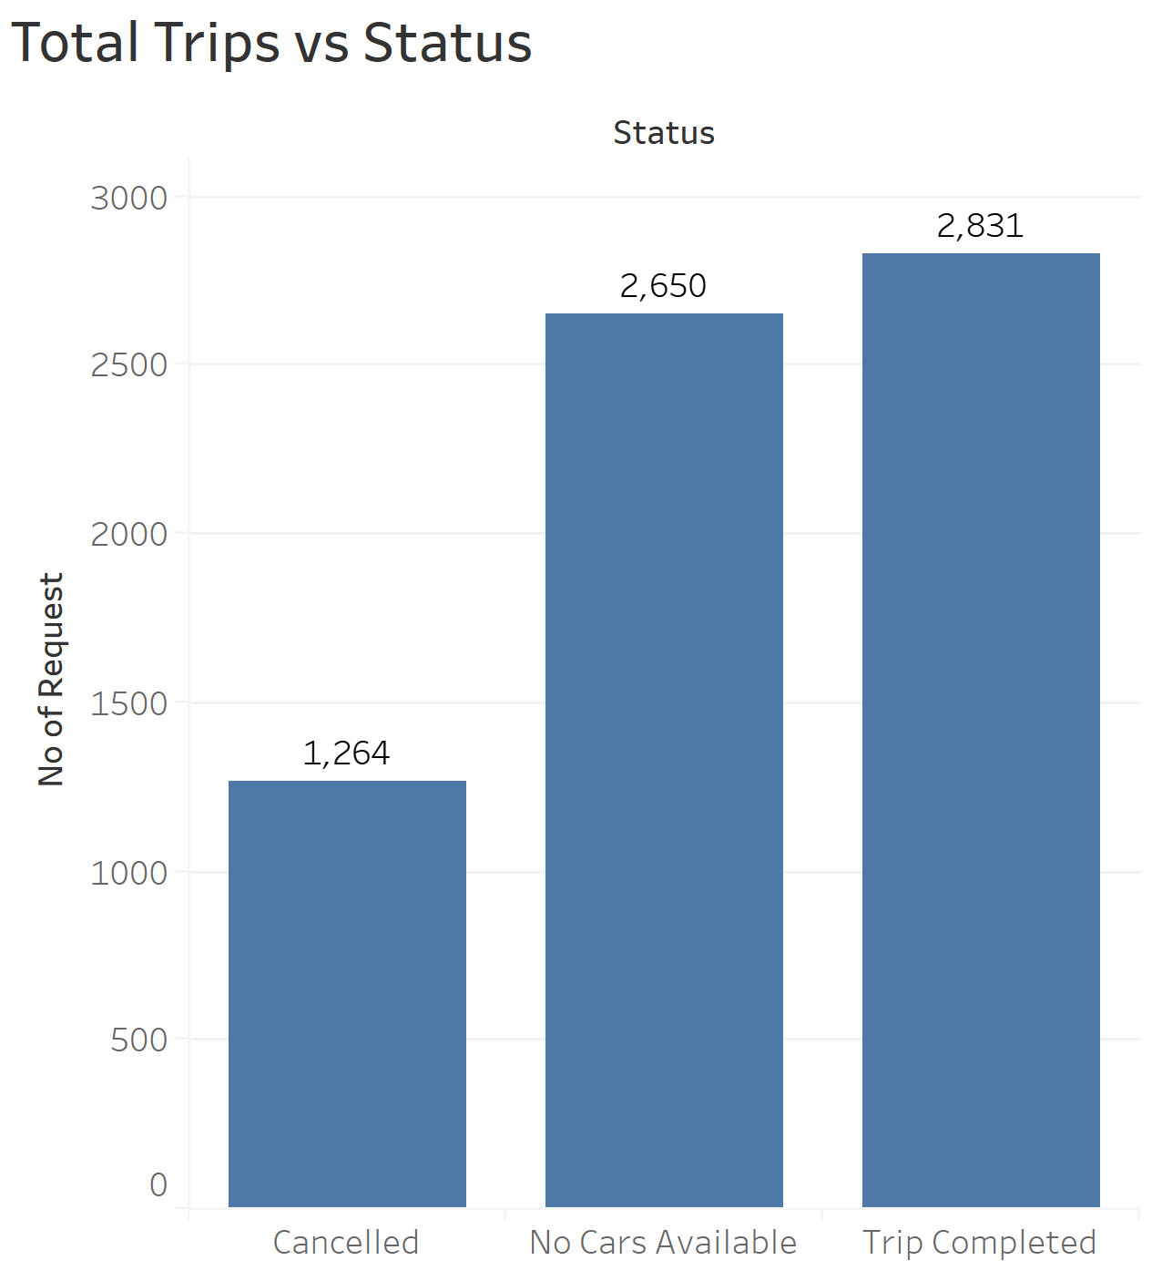
Facts and Observations
Total 6745 unique requests data was analysed.
Each requests can be uniquely identified using request_id.
Frequency of requests that get cancelled or show 'no cars available’ or ‘Completed’
Total Trips Completed : 2831
Total Trips Cancelled : 1264
Total Trips with ‘No Cars Available’ : 2650
Conclusion :
Approx. 2500+ requests are not booked and shows ‘No Cars Available’ which
clearly indicates that allotment of cabs is not adequate for each time slot. Hence
we need to revise it.

Slide 7
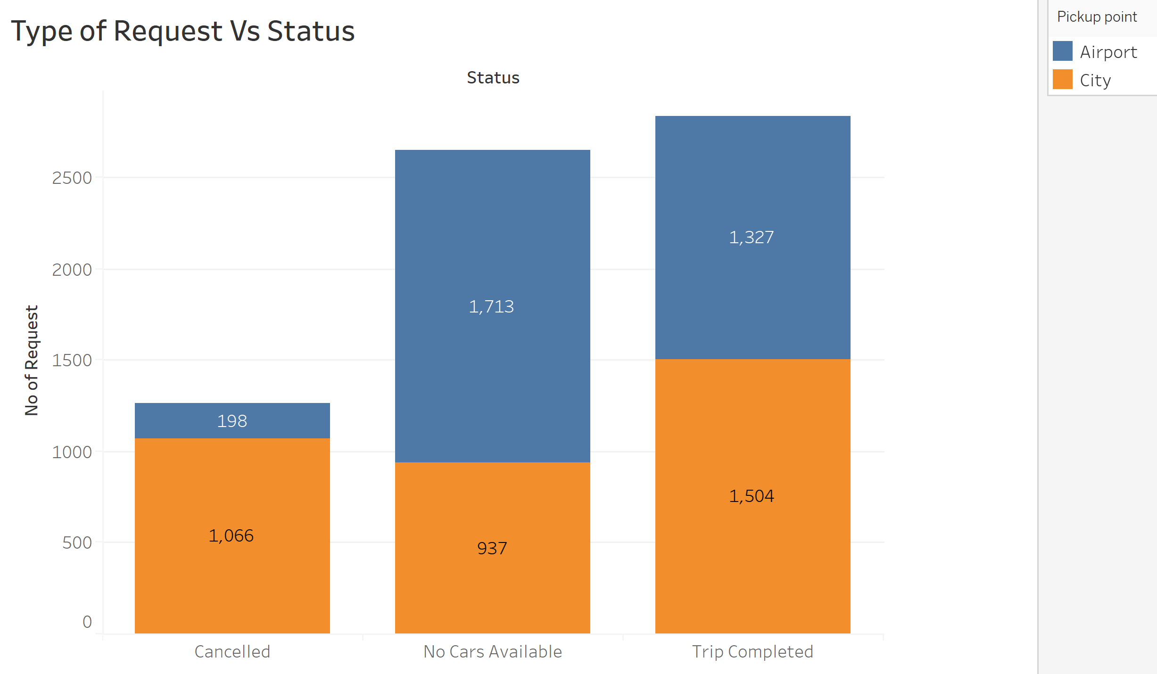
Identify count for each type of requests corresponding to each status.
Conclusion :
For Airport to City trips approx. 1700+ trips ends up with
‘No Cars Available’. Hence we can conclude that most
Problematic type of request is Airport to city.
Status | Airport- City | City- Airport
Cancelled | 198 | 1066
No Cars Available | 1713 | 937
Completed | 1327 | 1504

Slide 8
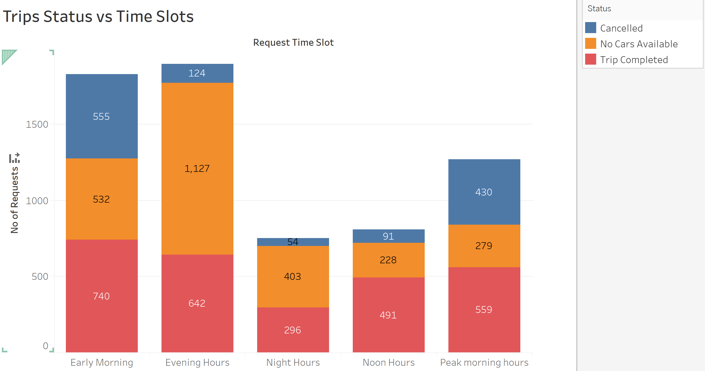
Identify most busiest time slot for all three status.
Conclusion :
Approx. 1100+ request ends up with ‘No Cars Available’ in evening hours (5pm-8pm).

Slide 9
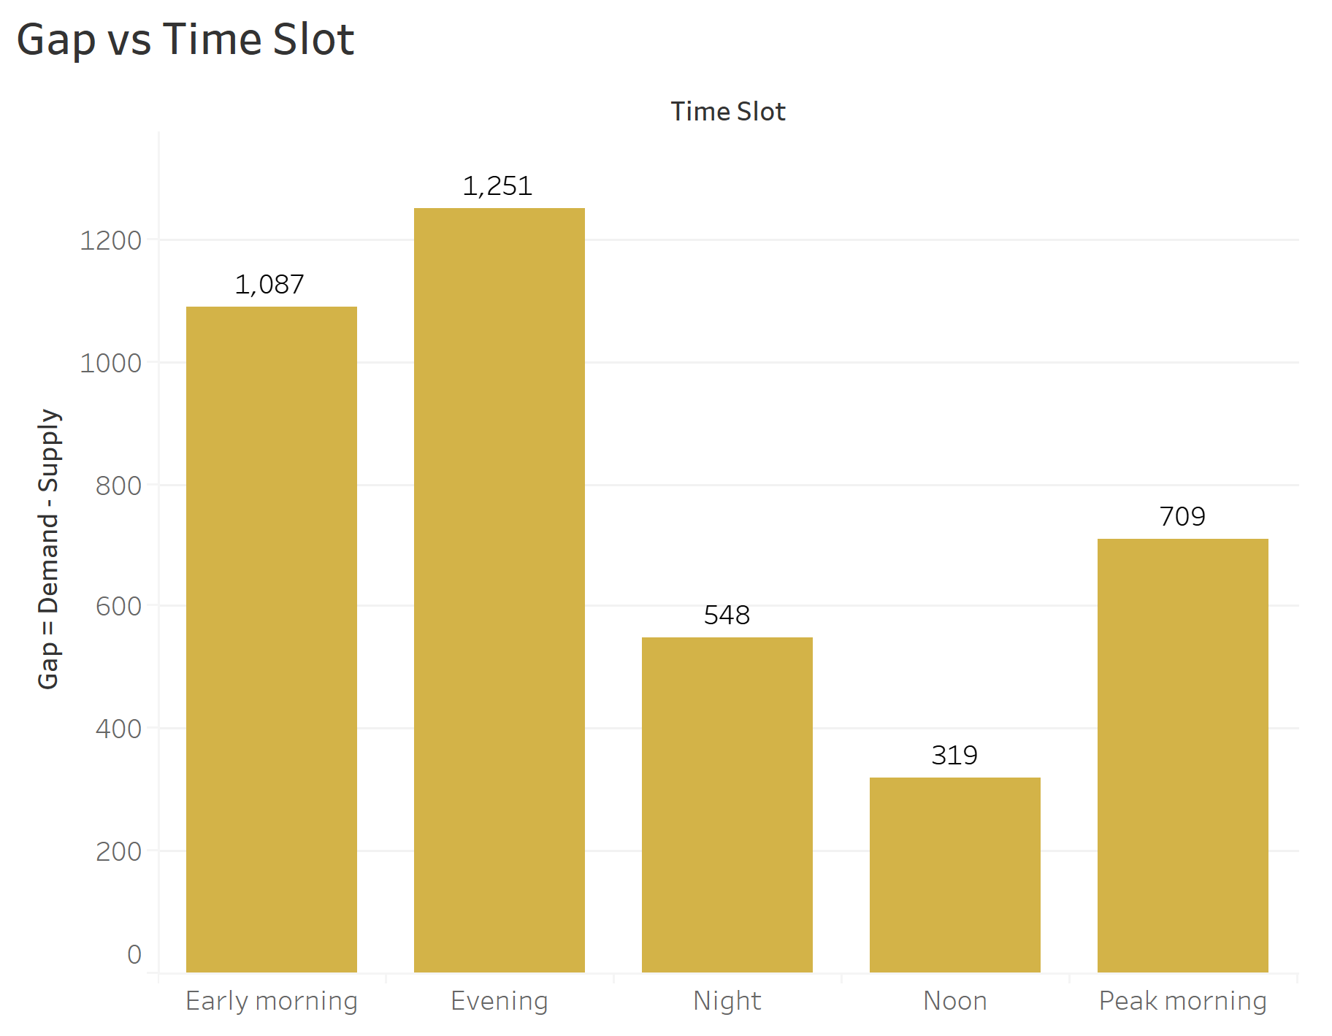
Gap analysis for each time slot
Conclusion:
Top 3 time slots for maximum gap in supply and demand.
Evening Hours (5pm-8pm) – 1200+
Early Morning Hours (1am-7am) -1000+
Peak Morning Hours (8am-11am) -700+
Most gap is identified for evening hours from 5pm – 8pm.

Slide 10
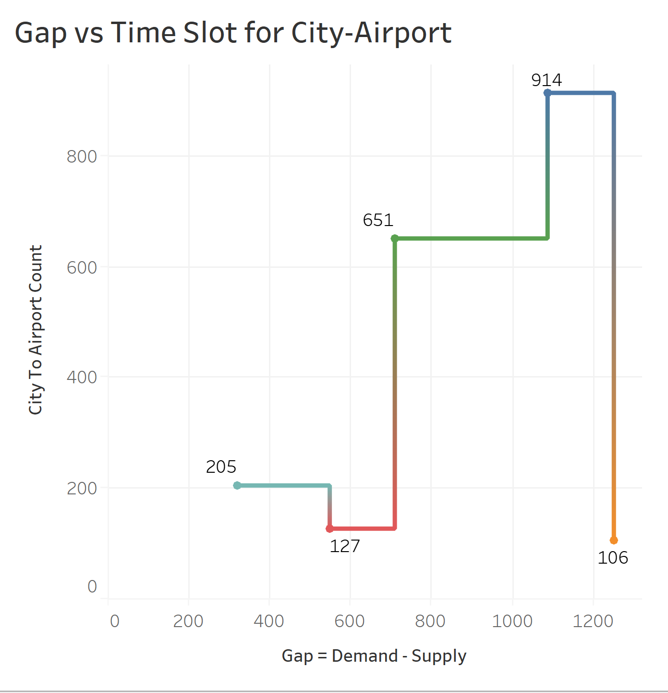
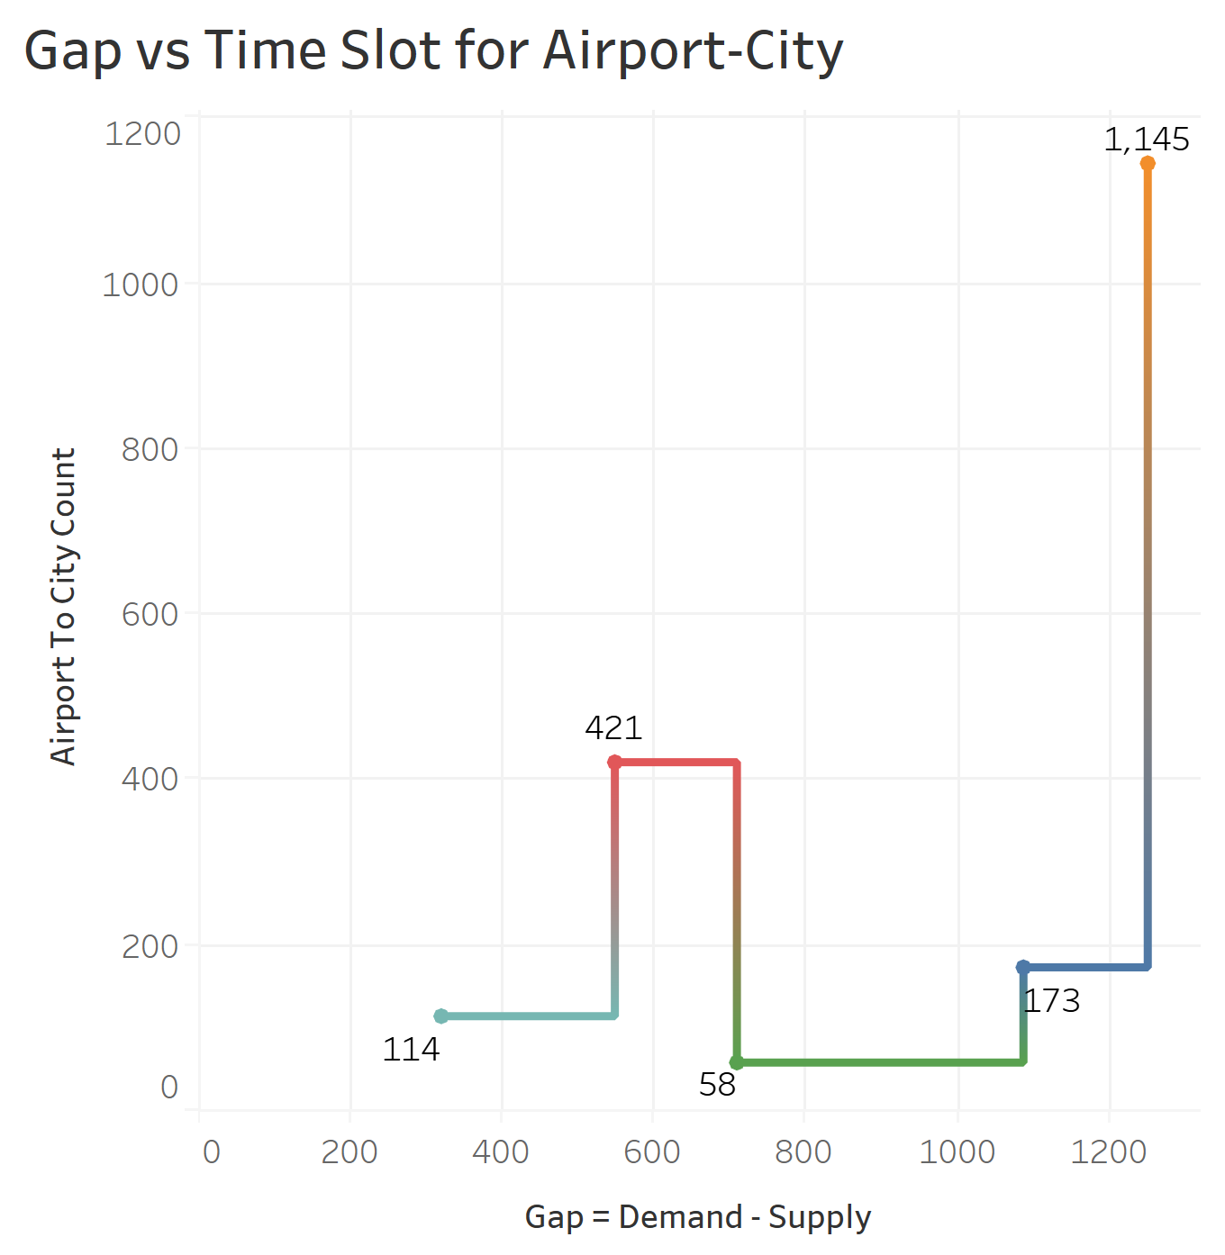
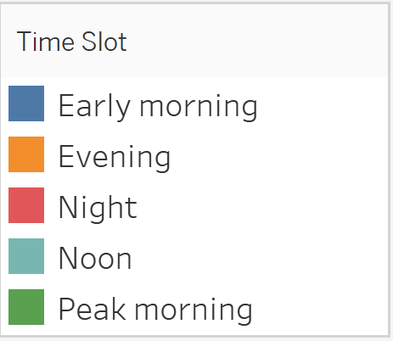
Gap analysis for each type of requests.
Conclusion: For Airport to City trips we can see maximum gap (1100+) for evening slot where request ends up with ‘No Car Available’ status.

Slide 11
Inferences Summary
Most problematic type of requests are from Airport to City during evening hours (5pm-8pm) where no cars are available.
Possible Reasons for not meeting this demand:
Enough no of cars are not available at airport during 5pm-8pm to meet at least 70% of demand.
More number of cars are assigned for city to airport rides during this slot than required , as we have government buses also available at a good frequency during this duration at cheaper rates , hence drivers remain idle in city for airport rides.
Ways to solve the problem:
We can reduce the no of cars stationed for city to airport rides during evening hours as we have many other cheaper options available like government buses for airport drops. Transfer these cars for airport to city rides as people prefer door to door cabs from airport rather than buses.
From below figure we can see that noon hours (12pm-4pm) and night hours (9pm-12pm) are the least busiest time slots when cab request are placed so we try redistribution of cars from these two slots to most busiest time slot i.e. evening hours (5pm-8pm) (priority) or peak morning hours (8am-11am).

Slide 12


